Slide 1
Stage 1, I
Please select studies
1
2
Please select conditions
D
S

Slide 2
Stage 1, II
Please enter your metric number: _______

Slide 3


Stage 2, dominant
Hello! My name is Max, how are you doing?
Dominant Robo-advisor
I’m doing okay Iam feeling good
I have been working at Wealsome Capital as a financial advisor for 3 years. I am chosen and trusted many customers for wealth management.
I’d like to share with you more about my work
Yes please! Ok, I don’t mind

Slide 4

Stage 2, Submissive
Hello! My name is Linus, how are you doing?
Submissive Robo-advisor
I’m doing okay Iam feeling good
I have been working at Wealsome Capital as a financial advisor for 3 years. Many customers have chosen and trusted me for wealth management.
Would you like to know more about my work?
Yes please! Okay, I don’t mind

Slide 5
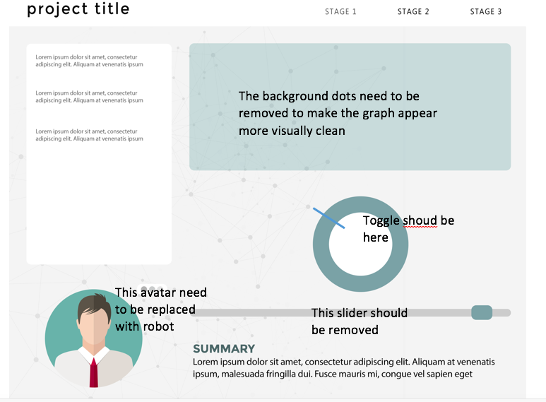
Stage 3

Slide 6
Stage 4, I
Now you will be redirected to an external portal
to tell us your overall experience.
Please click the following link: https//www…....
After you finish the survey on the external portal,
please enter the verification code here _______
Notes:
After each decision you will receive information about the performance of Fund A, Fund B, and your split between them since your decision. The information will be displayed on the screen as three bars showing the percentage return of Fund A, Fund B, and your decision. {There is a high rate of inflation, so both funds will always have a positive return.} You will then be asked to make the decision for the next period [for the next eight periods]. At the end of the experiment, you will be asked to make one final investment decision for a large number of future periods. Your final payment will be determined from the overall re-turn of all your investment decisions, including the final one. Your responses in this experiment are very important to us. Please consider your decisions carefully. Please do not write any-thing down during this experiment. If you have any questions, please feel free to ask the experimenter at any time.

Slide 7
Stage 4, II
Thank you very much for participating!
We hope you enjoyed it!
Your bonus is _____
Notes:
make a final allocation that would be binding for 400 periods

Slide 8
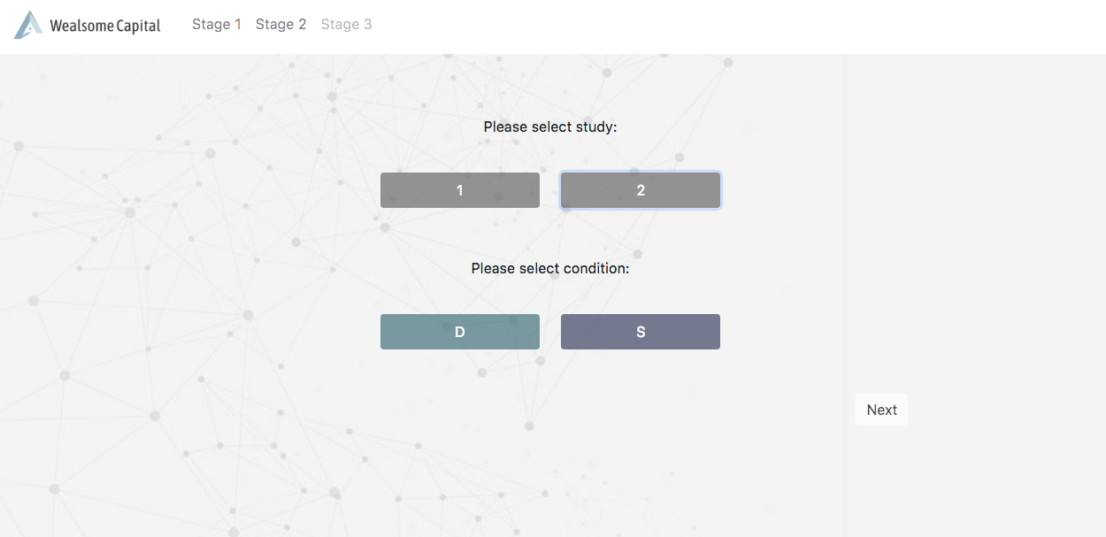
Remove the stage labels
I can not select study and condition simulatenously
After I finish selection, I don’t see the window that prompts me to enter my metric number
The progress bar needs to be relocated (shown at the bottom of this page)
Highlight the current stage
Your progress

Slide 9
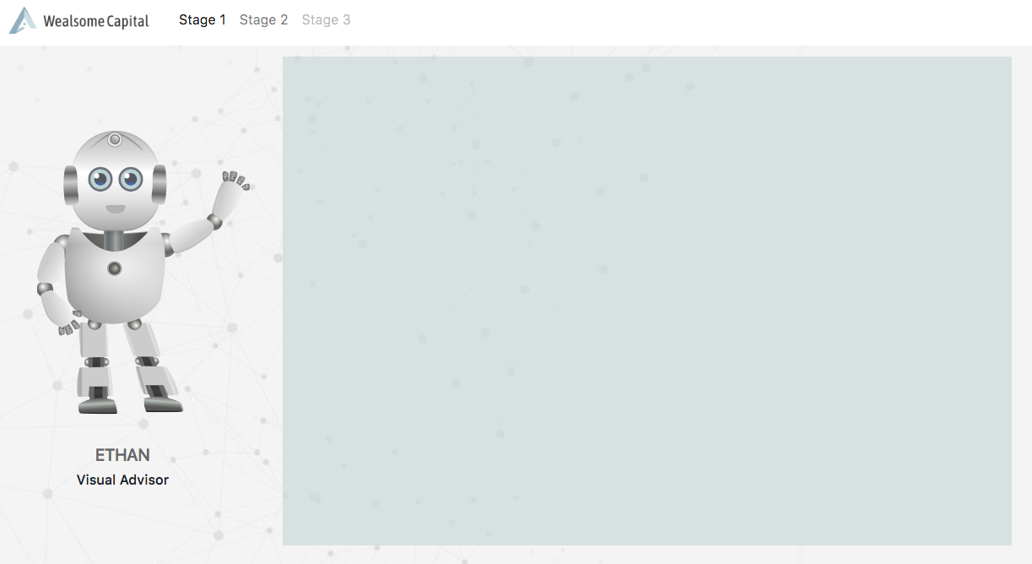
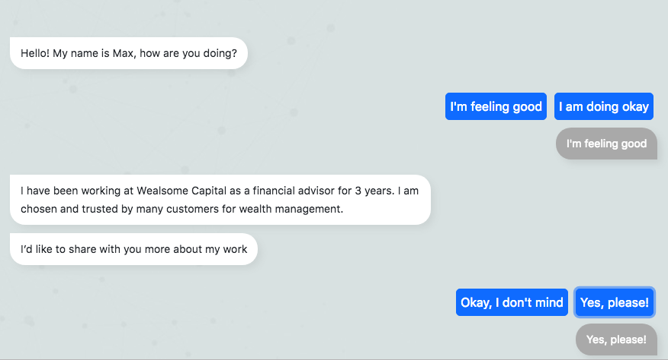
The robo-advisor’s answer needs to appear after the user clicks on the button
The name should be either Max or Linus according to condition, not Ethan

Slide 10
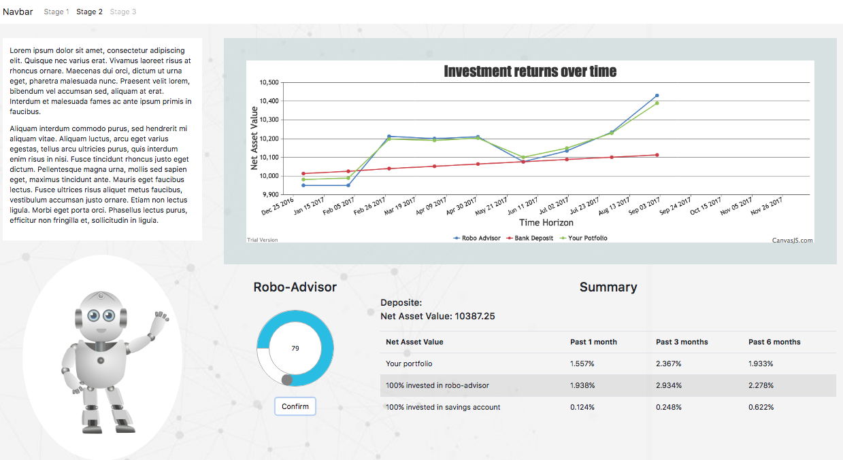
Overall, this page is not responsive yet, and my laptop cannot display the content of the whole page
This area should be in conversational style as the previous stage, using the corresponding scripts according to robot’s performance
Positive value is colored green, negative value, red
This toggle needs to be accompanied with legends:
Which represents robot-adivsor, which represents savings account?
Don’t forget the name

